Slide 1
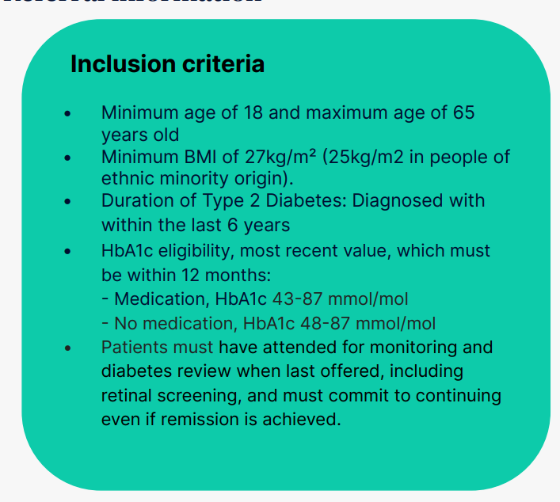
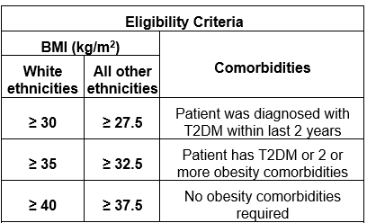
Bexley Weight Management Services
All newly diagnosed T2 diabetes & pre-diabetes pts must be referred to the following programmes below in the first instance including any pts who have not yet attended Diabetes Structured Education or NDPP
Tier 2 NHS Digital Weight Management Programme
BMI ≥ 30 (with adjustment for ethnicity)
Current diagnosis of diabetes (type 1 or 2) and/or hypertension
NHS England » The NHS Digital Weight Management Programme
National Diabetes Prevention Programme
Pre-diabetes or a previous gestational diabetes diagnosis
No BMI specification
Tier 2
Type 2 Diabetes Pathway to Remission Programme
formerly called the NHS Low Calorie Diet
Diabetes Book & Learn
Access to diabetes courses in south London including a bespoke self management course for people with T2 from African and Caribbean communities called HEAL-D
Patients can self refer to the service by completing the referral form on smart survey https://www.smartsurvey.co.uk/s/HEAL-D/
The NHS T2DR provided by Oviva is a type 2 diabetes 12 month behaviour change programme.
Diabetes clinicians help people with type 2 diabetes lose weight, increase physical activity and reduce their medication needs.
Tier 3 Healthy Weight Management Programme (GSTT)
This is a 12 month weight management programme for people who are living with
complex obesity and are registered with a GP in Bexley.
Aged 18 or over
To be eligible for obesity pharmacotherapy, your patient must be
highly motivated to change eating and exercise behaviours, and remain
actively engaged for at least 12 months
There is a choice of 2 group programmes: BALANCE OR KickStart (Total Meal Replacement)
BALANCE– Encourage you to make, steady and realistic changes to your diet and lifestyle to support healthy weight loss
KICK START – Greater weight loss within 1st 3mths. 800 calories a day for 3 months (See Page 3 for more info)
Tier 2 Adult Weight Management Service
12 week digital and targeted in-person programme for adults living in Bexley to lose and maintain a healthier weight long term with follow up at 6 and 12 months
Inclusion Criteria
For adults in Bexley (aged 18 years+) with a BMI equal to or greater than 30 kg/m2 (adjusted to 27.5 kg/m2 for those from a Black or Asian background).
Available to all Bexley adult residents (or non-residents registered with a Bexley GP.
Need structured support to lose weight, and previously unsuccessful in achieving and maintaining weight loss independently
Exclusion Criteria
Pregnant
Diagnosed with an eating disorder
Make a referral now by heading to www.grohealth.com/bexley
or contact a member of the Gro Health team on 0330 133 0307.
Tier 3
Oxleas Diabetes Dietetics Service
Tier 2
Specialist dietetic service to support patients with diabetes. Patients will be offered a 1:1 appointment with tailored diet and lifestyle advice to support optimisation of glycaemic control.
Patient must meet all of the following essential criteria:
Adult > 18yrs
Registered with Bexley GP
HbA1c ≥58mmol/mol (≥7.5%)
Patient must meet at least one of the below criteria, along with all essential criteria:
BMI ≥30kg/m² (or BMI ≥27.5kg/m² for individuals of BAME background) requiring weight loss due to impact on glycaemic control
BMI ≤18.5kg/m² or MUST ≥2 requiring weight gain
Poor glycaemic control (recurrent hyperglycaemia, uncontrolled hypoglycaemia due to suspected poor dietary management and/or medication not matching food intake)
Specialist services
Version 1 – August 2024

Slide 2
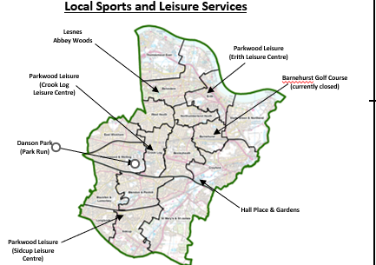
Bexley Weight Management Services
Community Services
Online Resources and Apps
Other Fitness Opportunities
Commercial companies
Weight Watchers – Self funded only
Slimming world – Self funded only
T2 Adult Weight Management Service
Please see Sport and fitness | London Borough of Bexley for the most up to date information
Diabetes UK
Diabetes NHS
Carbs & Cals
Couch to 5k
NHS LiveWell : Healthy Weight & Exercise
NHS Better Health
Low Carb Programme App
X-PERT – Junior Diabetes Education for Children pilot Tier 1 via Diabetes
Healthy Living
Park Run Bexley (Danson Park)
Fit Fans
Bexley Healthy Walks
Steps to Health
Silverfit
Get Active
Anytime Fitness
WALX of Wellbeing
Fit for Life
Self –referral
Please see Sport and fitness | London Borough of Bexley for the most up to date information
August 2024
Further information to follow…
Further information to follow…

Slide 3
Service | Overview | Target population | Who can refer | Eligibility criteria | Contact
Tier 2 - National Diabetes Prevention Programme Incentive Payment applicable | 9 month Behavioural change course aimed to support long term behaviour change for weight loss to prevent onset of diabetes. This is a Tier 2 weight management programme, run over 9 months with reducing intensity of contact. Offering face to face group sessions available in a range of community languages. A digital programme is also available run over the same 9 month period. Receive 1:1 support from a registered dietitian or nutritionist and peer support group. Track positive changes in activity, habits and weight loss. A tailored remote service will continue to pts in these cohorts:- Visual impairment & Hearing impairment support grps, BSL | Patients with non-diabetic hyperglycaemia (HbA1c 42- 47.9 m/mol), or history of gestational diabetes. BAME Groups pilots from Jan 2024 for Black African / Caribbean South Asian Portuguese Spanish | GP – Incentive applicable Patients can self-refer as long as they have their HbA1c result, the date it was taken (last 12 months) and their NHS number. NEW GDM Pathway access for women who have previously had gestational diabetes. Referrals can be received without a blood test. https://healthieryou.org.uk/gp/ | Aged 18-79 Not Pregnant Do not have diabetes currently HbA1c 42-47.9 (6.0-6.4%) or Fasting Plasma Glucose between 5.5-6.9mmol/within last 12 months If patient has a history of Gestational Diabetes (GDM) then patient is eligible with HbA1c <42 mmol/mol or FPG < 5.5mmol/l | Thrive Tribe Healthier You - Regional Manager - Mike Power Email:mike.power@thrivetribe.org.uk Engagement Lead - Malsa Ibrahim malsa.ibrahim@healthieryou.org.uk. https://healthieryou.org.uk/ hello@healthieryou.org.uk
The NHS Digital Weight Management Programme Incentive payment applicable | The new NHS DWMP offers free 12 week online access to weight management services to those living with obesity who also have either diabetes, or hypertension or both. With three levels of support and a choice of Providers, it is designed to offer service users a personalised level of intervention to support them to manage their weight and improve longer term health outcomes. Level 1 – Digital only Level 2 – Digital with human coaching – 50 mins Level 3 – Digital with human coaching plus - 100 mins | For adults living with obesity plus a diagnosis of diabetes or hypertension or both. To improve inequalities in prevalence of obesity Access to weight management services Risks of adverse health outcomes associated with obesity | GP practice Referral via e-RS Clinical templates available from SystemOne, EMIS and Vision IT Systems | Over the age of 18 Has a BMI of 30+ (adjusted to >27.5 for people from Black, Asian and ethnic minority backgrounds Has a diagnosis of diabetes (T1 or T2) or hypertension or both | NHSE
Tier 3 SEL Healthy Living Programme (formerly the South East London Healthy Weight Programme) is a Tier 3 weight management service delivered by Guy’s and St Thomas’ NHS Foundation Trust | The programme is an intensive 1-year course. It is for people who are living with complex obesity and are registered with a GP in Bexley, Bromley, Lambeth, Lewisham or Southwark. The programme pathway has recently been redesigned to reduce the length of time patients wait for a first appointment with the introduction of a “Discovery Session” which is a group education session which will become a patient’s first appointment in the programme. There is also a 1:1 service for those who are not suitable for groups, There is a choice of 2 group programmes: The Balance programme encourages you to make steady and realistic changes to your diet and lifestyle to support healthy weight loss. The KickStart programme features a total meal replacement for the first 3 months. You take in 800 calories a day for 3 months. After 3 months food is reintroduced during a 6-week period, alongside healthy lifestyle changes. | Support patients living with complex obesity | GP Referrals must be sent via e-RS available under “Dietetics” (speciality) and “Weight Management” (clinic type)) and “SEL Tier 3 Healthy Weight Programme” (service name) Blood Test Results are required to assess patient safety for very low calorie diets and eligibility for obesity pharmacotherapy. Referrals will be rejected if mandatory test results are not present. | There is a phased rollout of Wegovy (GLP-1 weight loss injection) due to limited NHS stock. The first phase is prioritising the highest need group who, for example, require weight loss for life saving or life altering treatments. For further Wegovy updates, please visit the South East London Integrated Care System website: Wegovy™ access in South East London – a further update - South East London ICS (selondonics.org). Exclusion criteria: Pregnant or planning pregnancy Those receiving palliative or end of life care Myocardial infarction or stroke with last 3 months Blood pressure readings of >120mm Hg Diastolic OR >180 mm Hg systolic (consider re-referral when blood pressure is optimised within this range) | GSTT Email gst-tr.tier3@nhs.nhs

Slide 4
Service | Overview | Target population | Who can refer | Eligibility criteria | Contact
Steps to Health | Crook Log, Erith and Sidcup Leisure Centre’s EXERCISE REFERRAL PROGRAMME Steps to Health is an Exercise Referral Programme which provides a safe, supervised and enjoyable introduction to physical activity within a controlled environment. The programme gives members who are not regularly active, or who have health problems, making sure they exercise in safe, supervised and enjoyable way. The programme is ongoing but the first 12 weeks involve: Wk1 – Welcome meeting including first health assessment WK2 – Cardio Vascular Induction Wk 3 – Upper Body Resistance Induction Wk 4 – Lower Body Resistance Induction Wk 5 – Lifestyle Coaching Wk6 -12 – Exercising independently (but instructors available if needed) Wk 12 – Second Health Assessment and discussing progression plus additional Health Assessments on Weeks 26-52 | You will find the programme beneficial if you have: Type 1 or Type 2 Diabetes Otho/Musk. Skeletal Stable Angina Depression / Anxiety Pulmonary Disease Post MI / Cardio Surgery Neurological (Parkinson’s, Stroke, MS etc) Obesity Cancer Osteoporosis Arthritis Fibromyalgia Hypertension CVA | Self referral or if patient has any of the conditions listed in the previous column. They are advised to talk to their GP or health practitioner about how health and physical activity would help them. GP can then refer to the Exercise Referral Programme by completing an exercise referral form. A member of the team will contact patient to book consultation. Referrals to be sent to : Crook Log Leisure Centre Brampton Road Bexleyheath DA7 4HH Bexley.s2h@lexleisure.org.uk Or via secure email address: S2hdebbie.brown1@nhs.net Tel. l 0203 887 3360 | If you are looking to improve your mental health and wellbeing or have a medical condition then this programme could be right for you. Cost: Exercise Referral Instruction will talk through best options available at the welcome consultation. | Crook Log Leisure Centre Brampton Road Bexleyheath DA7 4HH Bexley.s2h@lexleisure.org.uk Or via secure email address: S2hdebbie.brown1@nhs.net Tel. l 0203 887 3360 Leisurecentre.com
Low Carb Programme App | The NHS-approved behaviour change platform supports people to achieve self-selected health goals by reducing the amount of carbohydrates in their diet to 130 grams a day. Users are empowered with structured education, health coaching, community forum, virtual meetups, food diary, and an AI-powered meal plan generator providing plans tailored to patients’ health, budget, dietary preferences and cultural norms to engage and sustain long-term behaviour change. | Available to residents in SE London with T2 Diabetes. | Self Referral / GP through Book and Learn Platform | Suitable for people with Type 2 diabetes, prediabetes and obesity in SE London | Low Carb Program - Sustainable Weight Loss and Blood Glucose Control
Universal prevention – Live Well 0800 470 4831 | Maintaining healthy weight, being physically active, not smoking, lower risk alcohol consumption – 1:1 personal support and access to a range of programmes, including Live Well Coaches. Support available via freephone number 0800 470 4831, 6 days a week |  | Self referral or e-referral by clinician |  | Charlton Athletic Community Trust

Slide 5
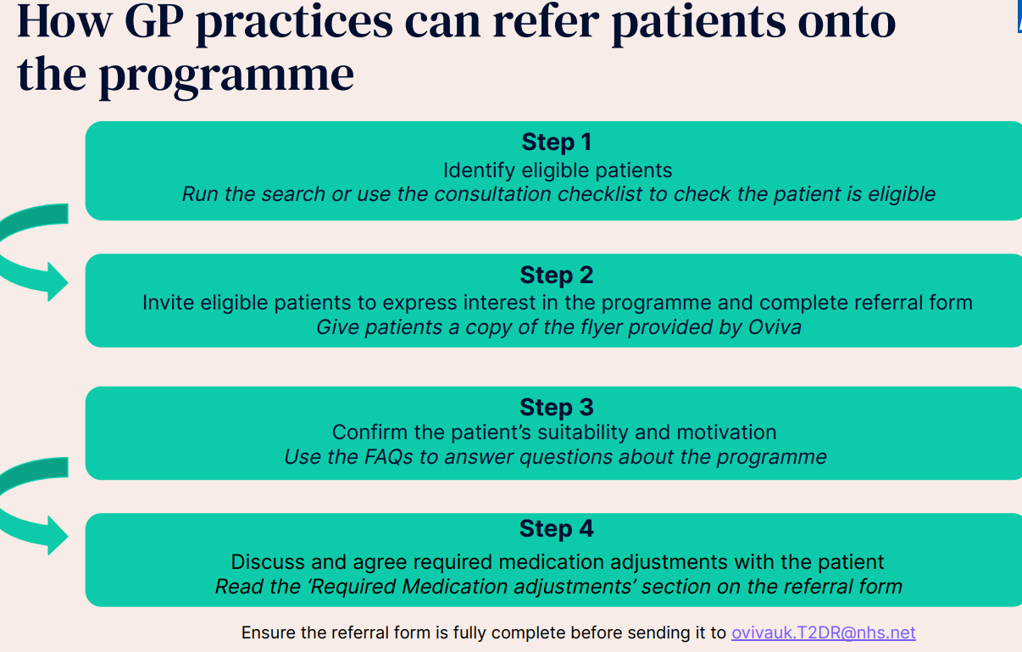
Service | Overview | Target population | Who can refer | Eligibility criteria | Contact
NHS T2DR Type 2 Diabetes Pathway to Remission formally known as Low Calorie Diet Provider Oviva The NHS Type 2 Diabetes Pathway to Remission Medications Guidance Video - YouTube | How is works? The NHS is delivering a new programme which provides a specially formulated diet for 3 months followed by healthy lifestyle support, for people who are living with type 2 diabetes and obesity, or overweight. Eligible participants will be offered low calorie, total diet replacement products including soups and shakes consisting of 800 to 900 kilocalories a day for up to 12 weeks. During this time participants will be expected to replace all normal meals with these products Alongside this, participants will receive support for 12 months including help to re-introduce food after the initial 12- week period. This support will provide participants with the help and advice they need throughout every stage of the programme. GP practices will be kept informed of patient progress and if any medication changes might be needed. | People with a confirmed Type 2 diabetes diagnosis within the last 6 years, obesity, or overweight, and are committed to lose weight, improve their blood sugar levels, reduce diabetes-related medication and, in almost half of participants, put their type 2 diabetes into remission | NHS Type 2 Diabetes Pathway to Remission Programme for primary care | Oviva UK | Primary care responsibilities are as follows: To ensure all relevant staff at the practice have read and understood the protocol before referring patients To ensure patients who are referred are eligible (as per criteria) and informed (T2DR is not for everyone) Carry out 6 and 12 month reviews to measure HbA1c and review medications, and share the results with Oviva To make telephone calls/appointments available within 2 weeks of request to review patient case and change medications in case of an adverse event Establish a clear channel of communication via NHSmail | Please contact ovivauk.T2DR@nhs.net if you have any question Click on the link to find training videos, mediation guidance, patient leaflets etc NHS Type 2 Diabetes Pathway to Remission Programme for primary care | Oviva UK
Gro Health - Tier 2 Adult Weight Management Service – 12 week Programme Provider DDM Health Ltd | Offering both a digital and a targeted in person programme To support adults living in Bexley to lose weight and maintain a healthier weight long term through adopting a healthier lifestyle DDM support service users for 12 months. This is initially a 12 week programme with follow up appointments scheduled at week 26 and 52 with a health coach. For digital users they can access the online programme on demand for 12 full months. | Digital or Face to Face Offer For adults in Bexley (aged 18 years+) with a BMI equal to or greater than 30 kg/m2 (adjusted to 27.5 kg/m2 for those from a Black or Asian background). People from lower socio-economic backgrounds/living in deprived areas of the borough People from Black and Asian background Men | Referrals: HCPs/VSCEs/local services can refer residents, or residents can self-refer Referrals are received through a bespoke landing page, telephone, email or DXS to the Gro Health Triage Team • Eligibility is confirmed with prospective users via telephone and/or instantly online | Inclusion Criteria For adults in Bexley (aged 18 years+) with a BMI equal to or greater than 30 kg/m2 (adjusted to 27.5 kg/m2 for those from a Black or Asian background). Available to all Bexley adult residents (or non-residents registered with a Bexley GP. Need structure support to lose weight, and previously unsuccessful in achieving and maintaining weight loss independently Assessed as “ready to change” Exclusion Criteria Pregnant Diagnosed with an eating disorder | For more information about making a referral head to www.grohealth.com/bexley or contact a member of the Gro Health team on 0330 133 0307.

